Slide 1
MONOCHROMATIC IMAGE DEHAZING USING ENHANCED FEATURE EXTRACTION TECHNIQUES IN DEEP LEARNING
PAPER ID- ICECONF-23-T3-309
Nisarg Nilesh Doshi
Sagar Bhavsar
Dr.D.Rajeswari

Slide 2
Table of contents
Sr. No | Content | Page No.
1 | Introduction | 3
2 | Motivation | 4
3 | Innovation idea of the project | 5
6 | Architecture diagram | 6
7 | Modules Descriptions | 7
8 | Algorithms used-(with Explanation) | 11
9 | Model Estimation | 12

Slide 3
Introduction
Small particles suspending in the atmosphere (e.g., droplets and dusts) often scatter the light.
As a consequence, the clarity of an image would be seriously degraded, which may decrease the performance of many multimedia processing systems.
Image enhancement methods developed using image processing technique to recover image details can only alleviate this problem slightly.
The rapid development of technologies such as AI, ML, CV has led to renewed research into improved image dehazing techniques.

Slide 4
Motivation
An image can also be viewed as a bundle of graphical data that can be extracted.
Data is extracted from images in all kinds of sectors:
Military and law enforcement personnel can use image data to potentially prevent military attacks.
It can be feed to AI, ML machines to train them to be more efficient.
For example the ML algorithm of an autonomously driven car is fed all kinds of sign boards for the car to adjust accordingly.
The potential for computer vision is vast, with that being said, there is still a lot of work to be done in this segment especially on the most critical part of making image unambiguous by dehazing it.

Slide 5
Innovation idea of the project
The basic idea behind the algorithm used for image dehazing is :-
Give the algorithm hazy image as Input
Apply pre-processing to the given images to get output as intermediate image
Apply deep learning algorithm to the intermediate image
Get clear image as output
Calculate the efficiency of the algorithm (PSNR value)

Slide 6
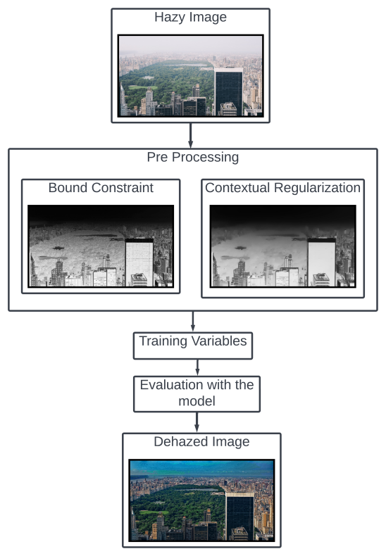
Architecture Digram

Slide 7
Modules
DATASET
The dataset can be classified into two categories:
Clear Images
Hazy images
PRE PROCESSING TECHNIQUES:
Boundary constraint
Contextual regularizatio
CNN ARCITECTURE
VGG16
AlexNet
DenseNet
ResNet

Slide 8
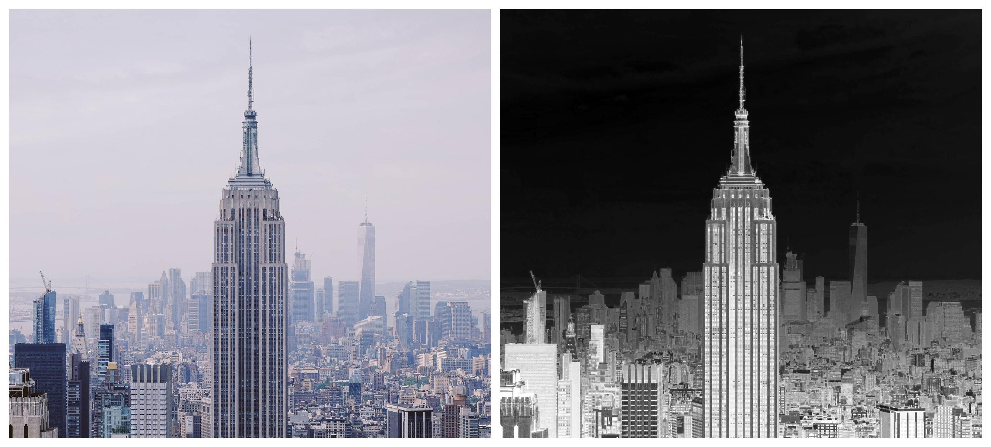
Pre processing Result - Boundary Constraint

Slide 9
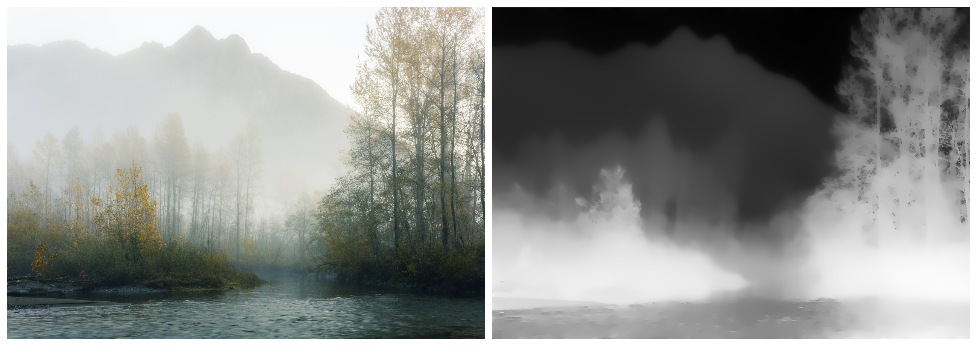
Pre processing Result - Contextual Regularization

Slide 10
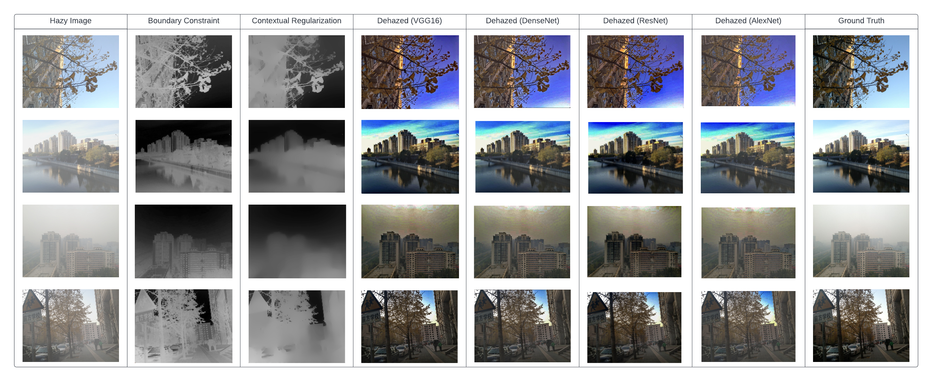
Complete life cycle of the image
Result Comparison between various CNN models

Slide 11
Algorithm Used
The basic idea behind the algorithm used for image dehazing is :-
Give the algorithm hazed image as Input
Apply pre-processing steps to the given images to get output as intermediate image.
Apply deep learning algorithm to the intermediate image (VGG16)
Get clear image as output
Calculate the efficiency of the algorithm (PSNR value and SSIM value)
Models used: VGG16, AlexNet, ResNet, DenseNet

Slide 12
Model Estimation
A. Peak Signal-to-Noise Ratio (PSNR)
The PSNR is the ratio of the strongest possible signal to the strongest possible noise that impairs the representation of a picture. The PSNR of an image can be calculated by comparing it to a theoretically perfect, noise-free version of the same image.
B. Structural similarity index measure (SSIM)
Digital images and videos of all kinds can have their perceived quality predicted using a technique called the SSIM, which is also used to measure structural similarity between two objects. Similarity between two images can be evaluated with the help of SSIM.

Slide 13
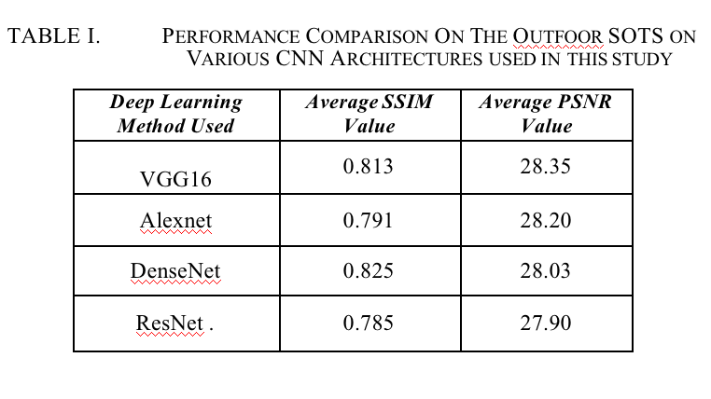
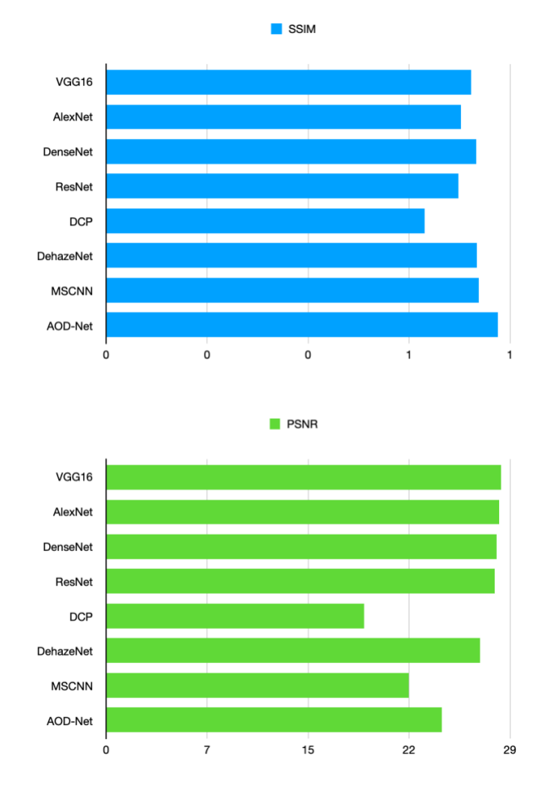
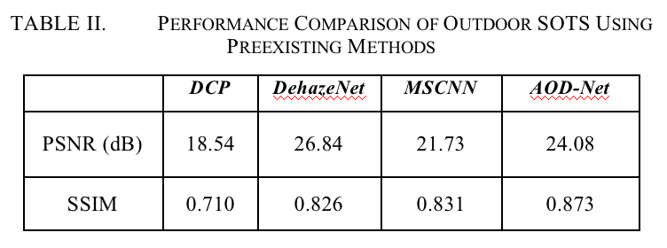
Model Estimation

Slide 14
Thank You !

